Slide 1
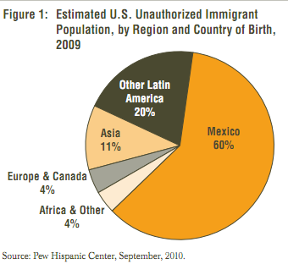
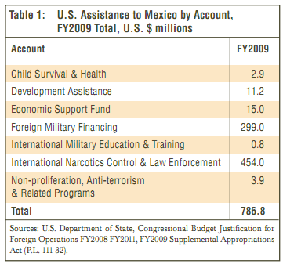
Development and Migration in Rural Mexico
Stronger Policies
60% of Illegal Immigration is Mexican
Need of Rural Development Projects

Slide 2
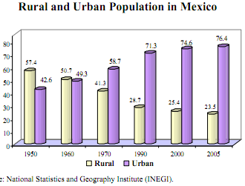
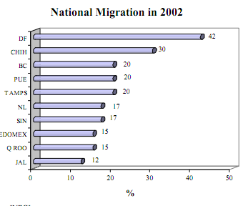
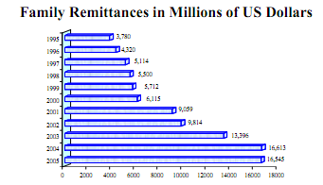
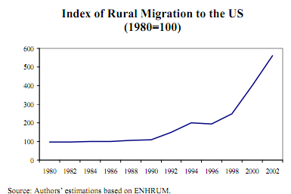
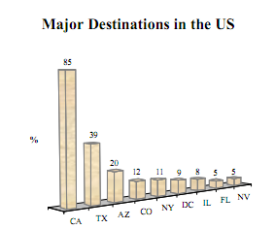
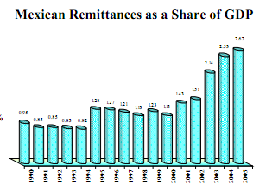
Rural Migration in Mexico
Important component of globalization and economic development
No opportunities in Rural Areas
Transition from Rural to Urban Economy

Slide 3
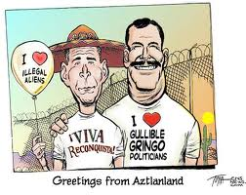
Incentives for Rural Migration
Econmomic Incentives
«underdevelopment may drive migration because the income structure is highly segmented between urban and rural areas”
Non-economic Incentives
Migrant Networks
The US process of immigrant legalisation
Land reforms
Accumulated effects
Higher security measures in the US border
“Both countries have not been very effective in preventing rural migration”

Slide 4
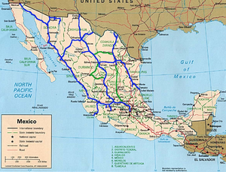
The Risks
The risk of starvation and dehydration
The risk of being stolen
The risk of being tricked by smugglers
Forced to participate in illegal acts, such as: Drug Traffic
Robbing
Kidnapping
Etc.

Slide 5
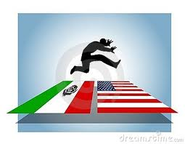
What’s Happening Today?
UNITED STATES OF AMERICA
Illegal Inmigration has decreased.
Due to:
More strict laws.
Border Patrol is tougher
Reinforced the country’s 1,969-mile
border with its southern neighbor
MEXICO
Illegal Immigrants who are returned (taken out of the US) stay on the Mexican Side of the border so cultures and races are being mixed.

Slide 6
Discussion Questions
How should policies be designed so that can they can create employment and income opportunities in rural areas to slow-down migration?
What would happen if migration is stopped completely?
If you were in one of these unfortunate situations in a LDC’s, what would you do in order to help your family and had the chance to migrate?

