Slide 1

Food Security and Cultural Connectedness
Rural Sustainability

Slide 2
Outline
1. Introduction
2. Food Security and Sustainability
3. Food Systems in Rural Communities
4. Culture, Food Security, and Rural Sustainability

Slide 3

1. Introduction
What keeps communities well, helps them adapt to change, helps them organize in sustainable ways?

Slide 4
Outline
1. Introduction
2. Food Security and Sustainability
3. Food Systems in Rural Communities
4. Culture, Food Security, and Rural Sustainability

Slide 5
2. Food Security and Sustainability
Food Security:
“Access by all people at all times to enough food for an active, healthy life. It includes at a minimum,
  (a) the ready availability of nutritionally adequate and safe foods, and
  (b) the assured ability to acquire acceptable foods in socially acceptable ways.”
Anderson, 1990

Slide 6
2. Food Security and Sustainability
What are some factors that affect a person’s food security?
Food insecurity often equated with poverty
  E.g., “in the past year I did not have enough money to buy food”
Does lacking money necessitate food insecurity (in rural communities in particular)?
  What about people’s ability to acquire food from the land around them?
  Is health defined exclusively in the realm of the market economy?

Slide 7
2. Food Security and Sustainability
Reflection:
What are some factors, other than income, that affect food security? Are there factors unique to rural communities?
Prepare to discuss these in class.

Slide 8
2. Food Security and Sustainability
What is the relationship between food security and sustainability?
A truly sustainable community is one that is also food secure.
  Meeting today’s food needs without compromising the ability of future generations to meet their needs.
One step further…

Slide 9
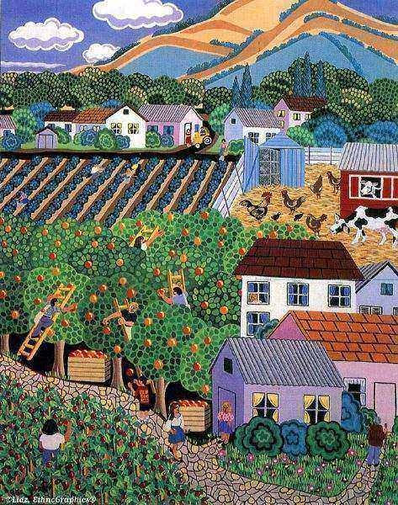
2. Food Security and Sustainability
In order to be food secure, one must live in a sustainable community.
If a community does not have the capacity to produce its own food in a sustainable way, are its citizens food secure?

Slide 10
2. Food Security and Sustainability
Reflection:
Are you food secure?
Is your community food secure?
What is the relationship between food security and sustainability?

Slide 11
Outline
1. Introduction
2. Food Security and Sustainability
3. Food Systems in Rural Communities
4. Culture, Food Security, and Rural Sustainability

Slide 12
3. Food Systems in Rural Communities
How does the global food system operate in your community?
For more on the state of the International Food System see trailers for:
  Food, Inc.: www.foodincmovie.com
  Dirt! The Movie: www.dirtthemovie.org

Slide 13
3. Food Systems in Rural Communities
Rural food producing communities experience impacts of this food system on environmental, economic, and human health.
Other rural communities also affected:
Northern residents depend mostly on the international food system; local food is considered a supplement.
Local food not widely available for purchase

Slide 14
3. Food Systems in Rural Communities
Local food behaviour N=21 Aboriginal people in Northern Ontario (Aroland)
Table 1. Mean and standard deviation of self-estimated frequency with which meals include a given local food by season.
 | Winter | Spring | Summer | Autumn
Fish | 1.65 (1.20) | 2.03 (1.22) | 2.14 (1.20) | 1.59 (1.34)
Blueberries | .57 (1.00) | .50 (.96) | 2.20 (1.03) | .82 (1.25)
Wild Rice | 0.00 (0.00) | 0.00 (0.00) | .16 (.57) | .09 (.30)
Grouse | .45 (.91) | .59 (1.02) | .84 (1.09) | 1.20 (1.39)
* Note: 0=none, 1=a little, 2=some, 3=most, 4=all

Slide 15
3. Food Systems in Rural Communities
Local food behaviour N=21 Aboriginal people in Northern Ontario (Aroland)

Slide 16
3. Food Systems in Rural Communities
Local food behaviour N = 20 Aboriginal people, Ginoogaming
Where do you get your food? | Mean
Nearby Grocery Store | 4.2
Convenience Store | 3.3
Fishing | 3.25
Hunting | 2.85
Sharing | 2.75
Trapping | 2.05
Gathering Berries | 1.85
Big Grocery Store in Thunder Bay | 1.6
Growing Vegetables | 1.15
5 = Always; 4 = Often; 3 = Sometimes; 2 = Rarely; 1 = Never
Notes:
Food sources show Western and Indigenous integration but top two are mainstream.
Note important role of food sharing in the community
16

Slide 17
3. Food Systems in Rural Communities
Local food behaviour N = 20 Aboriginal people, Ginoogaming
How often do you eat these foods? | Mean
Bananas / Beef | 3.90
Potatoes | 3.89
Chicken | 3.72
Apples | 3.50
Oranges | 3.33
Lettuce | 3.06
Blueberries | 3.00
Pork / Raspberries / Fish | 2.72
Moose Meat | 2.56
5 = Very often; 4 = Often; 3 = Occasionally; 2 = A little; 1 = Not at all
Notes:
Largely western, mainstream
17

Slide 18
3. Food Systems in Rural Communities
Reflection:
How does the international food system affect your community? Through what mechanisms do these effects occur?

Slide 19
Outline
1. Introduction
2. Food Security and Sustainability
3. Food Systems in Rural Communities
4. Culture, Food Security, and Rural Sustainability

Slide 20
4. Culture, Food Security, and Rural Sustainability
What is culture?

Slide 21
4. Culture, Food Security, and Rural Sustainability
Culture is a unique and dynamic meaning and information system, shared and transmitted by groups of people to promote survival and well-being.
  Includes attitudes, values, beliefs, practices
  Includes conscious and unconscious aspects
Culture is a repository of shared knowledge
A pattern that evolved to help a group of people survive
Matsumoto & Juang, 2007

Slide 22
4. Culture, Food Security, and Rural Sustainability
Food is a primary survival need
Therefore, culture evolves as people acquire food and exchange the related knowledge
The quest for food builds culture
See McDonald (2005), Thu (2006)

Slide 23
4. Culture, Food Security, and Rural Sustainability
Reflection:
How do you access food? What food related knowledge do you have?
Where did you learn these food behaviours?
What values inform your food choices?

Slide 24
4. Culture, Food Security, and Rural Sustainability
Food values guiding food behaviour, N=20, Ginoogaming First Nation
When choosing food it is important to me that…
 | Mean
Cheap, Tasty, Easy, Convenient, Familiar, Available at Store | 3.65
Healthy, not Salty, Sweet, or Processed | 3.26
Connects me with cultural heritage, Comes from Land Nearby | 2.84
5 = Strongly Agree; 4 = Agree; 3 = Neutral; 2 = Disagree; 1 = Strongly Disagree
Notes:
These values guide food choices
24

Slide 25
4. Culture, Food Security, and Rural Sustainability
See also Jaffe and Gertler (2006) re “Consumer Deskilling and the transformation of food systems”

Slide 26
4. Culture, Food Security, and Rural Sustainability
Reflection:
Is the culture that is evolving in response to market-based food acquisition really suitable for long term survival and adaptation in place?
If culture evolves to support food acquisition and survival in a given place, what happens as our food system goes global?
Does the homogenization of the food system produce a homogenization of culture?

Slide 27
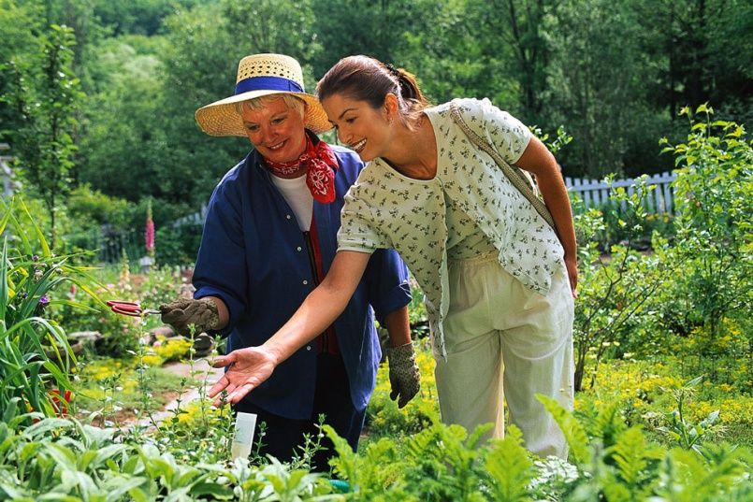
4. Culture, Food Security, and Rural Sustainability
Local food knowledge is going underground, forming a subculture
Locally rooted knowledge of food acquisition traded across generations within families
This knowledge is not recorded, accessible orally only for those who are connected and depends upon interested young people

Slide 28
4. Culture, Food Security, and Rural Sustainability
Participation in traditional food behaviour is associated with well-being and sense of cultural connection
As shown in two studies with Aboriginal communities:

Slide 29
4. Culture, Food Security, and Rural Sustainability
Key Correlations, N=20 Aboriginal people, Ginoogaming
 | Health | Life Satisfaction | Social Capital | Food Security
Food Source: Fish & Hunt | -- | .49* | .50* | --
Value Local & Culture | .59** | .67*** | .67*** | --
5 = Very often; 4 = Often; 3 = Occasionally; 2 = A little; 1 = Not at all
Notes:
29

Slide 30
4. Culture, Food Security, and Rural Sustainability
Key Correlations, N = 21 Aboriginal people, Aroland:
 | Fish - Winter | Fish – Spring | Fish - Summer | Fish - Fall
Life Satisfaction | .24 | .49* | .48* | .20
Connection to Nature | .47* | .37 | .46* | .52*
Connection to land | .22 | .23 | .65** | .49
Aboriginal cultural participation | .25 | .66** | .44 | .24
Sense of Purpose | .39 | .49 | .72** | .67**
Self-rated Health | .49* | .47 | .24 | .20
Self-rated Exercise | .40 | .51* | .49* | .54*
* P < .05
** p < .01

Slide 31
4. Culture, Food Security, and Rural Sustainability
Reflection:
What recommendations would you now make to strengthen sustainability and well-being in rural communities?

Slide 32
Outline
1. Introduction
2. Food Security and Sustainability
3. Food Systems in Rural Communities
4. Culture, Food Security, and Rural Sustainability

Slide 33
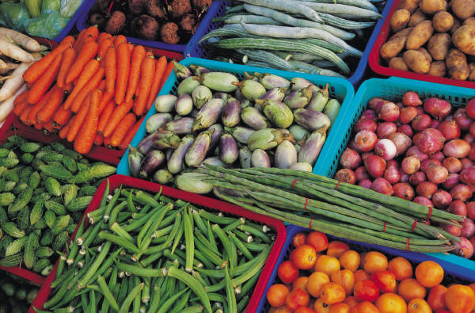
See you on Friday!
Reflect on the discussion questions posed in this presentation
Be prepared to engage in discussion on Friday.

